Slide 1

Hive and the Hadoop herd

Slide 2
Apache Hadoop projects
Pig—A high-level data flow language
Hive—A SQL-like data warehouse infrastructure
HBase—A distributed, column-oriented database modeled after Google’s Bigtable
ZooKeeper—A reliable coordination system for managing shared state between distributed applications
Chukwa—A data collection system for managing large distributed systems

Slide 3
HIVE
Hive is a data warehousing package built on top of Hadoop.
It began its life at Facebook processing large amount of user and log data.
Its target users remain data analysts who are comfortable with SQL and who need to do ad hoc queries , summarization , and data analysis on Hadoop-scale data.
Notes:
It’s now a Hadoop subproject with many contributors.
Hive was designed to appeal to a community comfortable with SQL. It's philosophy was that we don't need yet another scripting language.

Slide 4
Design of Hive
A system for managing and querying structured data built on top of Hadoop
Map-Reduce for execution
HDFS for storage
Metadata in an RDBMS
Key Building Principles:
SQL as a familiar data warehousing tool
Extensibility – Types, Functions, Formats, Scripts
Scalability and Performance
Interoperability

Slide 5
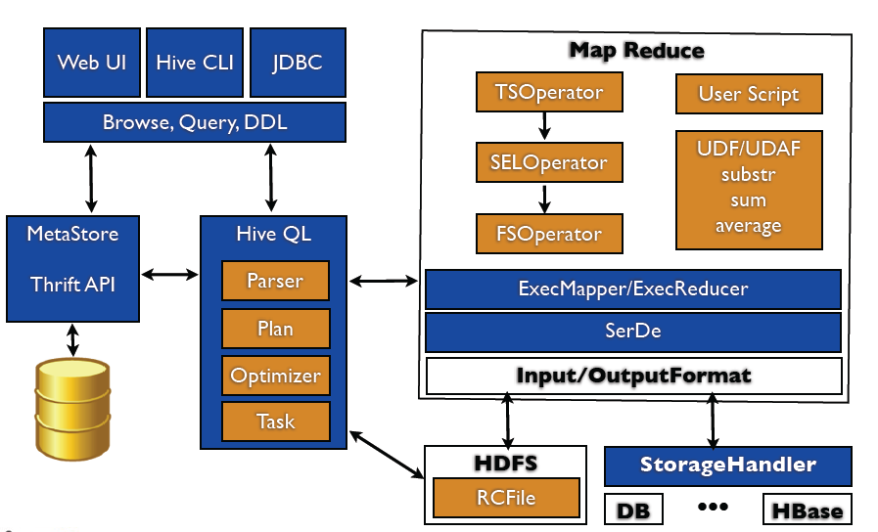
Hive architecture
Metastore for storing schema information.
typically resides
in a relational database.
interact with Hive a Web GUI
Java Database Connectivity (JDBC) interface
a command line interface (CLI ),

Slide 6
Physical Layout
Warehouse directory in HDFS
E.g., /user/hive/warehouse
Tables stored in subdirectories of warehouse
Partitions form subdirectories of tables
Actual data stored in flat files
Control char-delimited text, or SequenceFiles
With custom SerDe, can use arbitrary format
Source: cc-licensed slide by Cloudera
Notes:
SerDe is short for Serializer/Deserializer. Hive uses the SerDe interface for IO. The interface handles both serialization and deserialization and also interpreting the results of serialization as individual fields for processing.
A SerDe allows Hive to read in data from a table, and write it back out to HDFS in any custom format. Anyone can write their own SerDe for their own data formats.

Slide 7
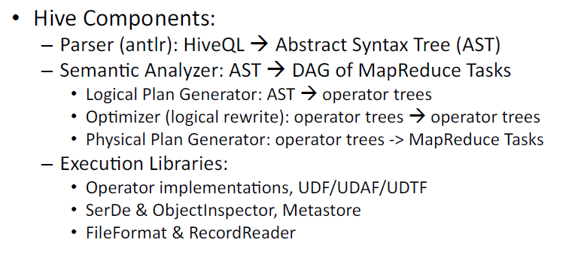
Conceptual Level Architecture
Hive Components:
– Parser
(antlr):
HiveQL

Slide 8
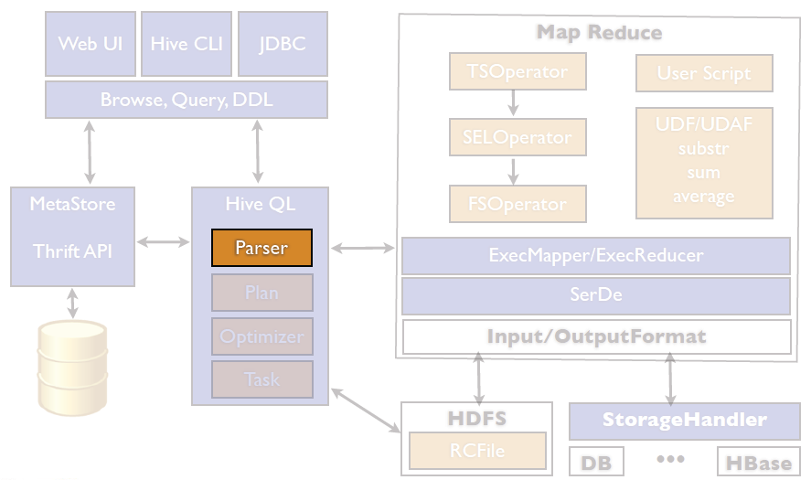
Hive Internal

Slide 9
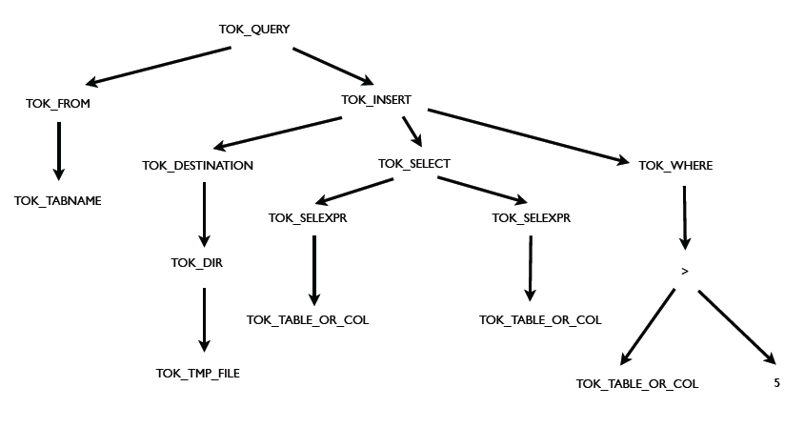
Parser
Select col1,col2 From tab1 Where col3 > 5

Slide 10
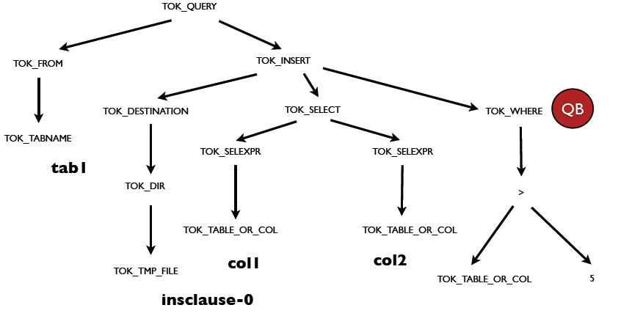
Parser

Slide 11
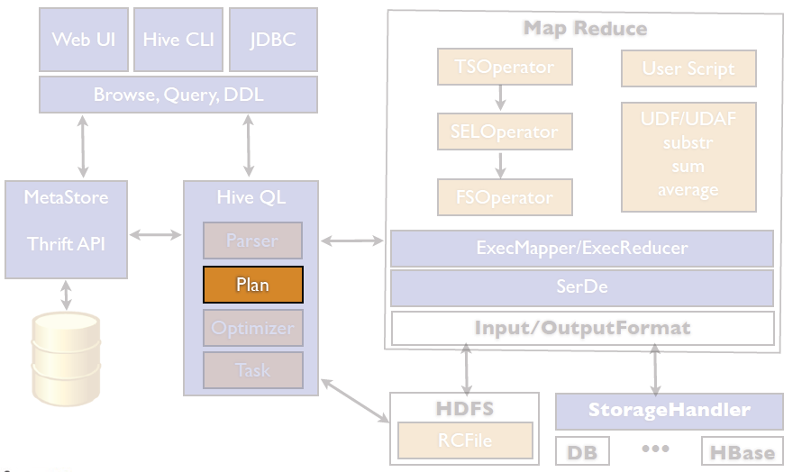
Hive Internal

Slide 12
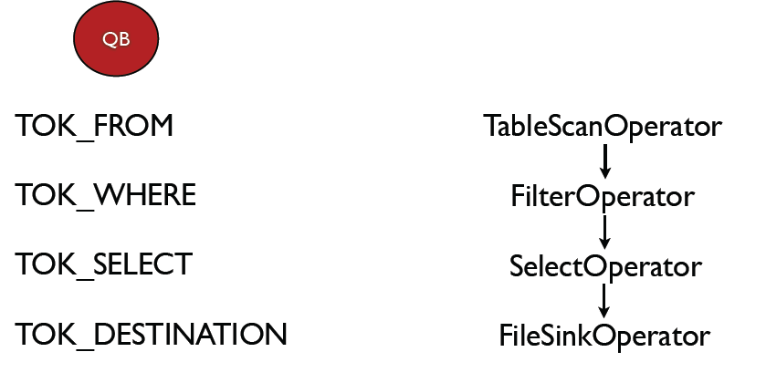
Plan
Select col1,col2 From tab1 Where col3 > 5

Slide 13
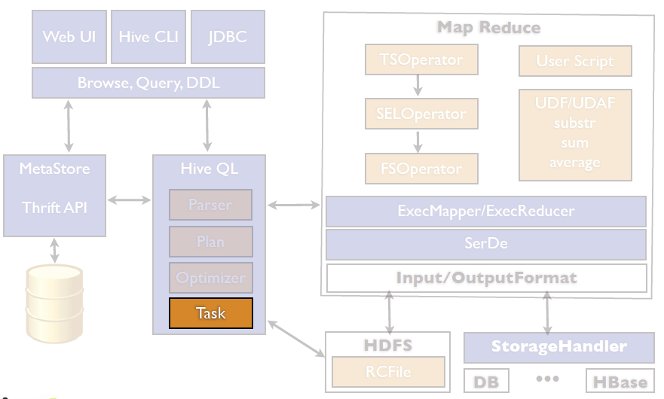
Hive Internal

Slide 14
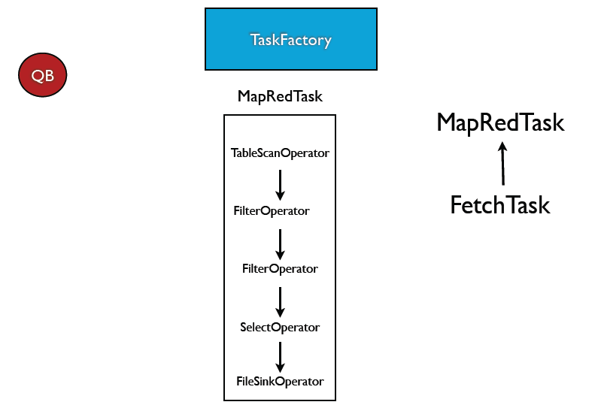
Task

Slide 15
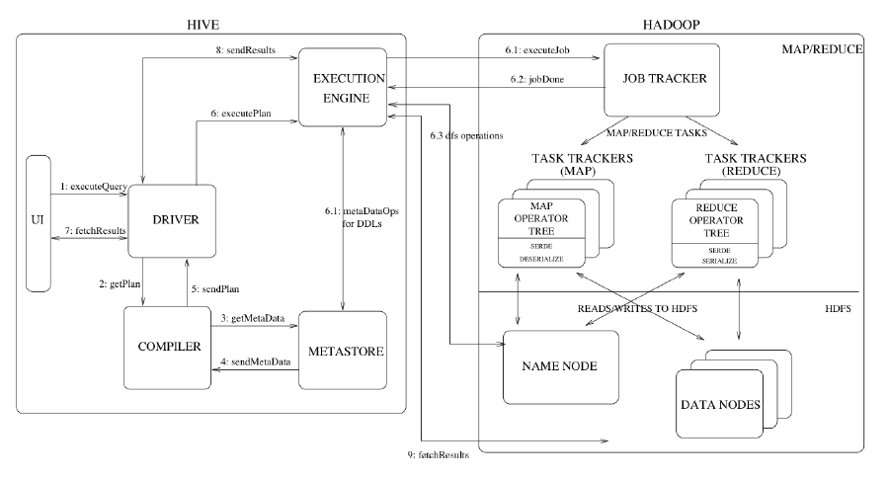

Slide 16
HiveQL
SQL-like language called HiveQL
It separates the user from the complexity of MapReduce programming.
It reuses familiar concepts from the relational database world
Lacks support for transactions
Notes:
HiveQL offers extensions not in SQL, including multitable inserts and create table as select, but only offers basic support for indexes. Also, HiveQL lacks support for transactions and materialized views, and only limited subquery support.[9][10] There are plans for adding support for insert, update, and delete with full ACID functionality.

Slide 17
Example queries
hive> CREATE TABLE cite (citing INT, cited INT)
> ROW FORMAT DELIMITED
> FIELDS TERMINATED BY ','
> STORED AS TEXTFILE;
OK
Time taken: 0.246 seconds

Slide 18
Example queries
hive> SHOW TABLES;
OK
cite
Time taken: 0.053 seconds
hive> DESCRIBE cite;
OK
citing int
cited int
Time taken: 0.13 seconds

Slide 19
Example queries
hive> LOAD DATA LOCAL INPATH 'cite75_99.txt'
> OVERWRITE INTO TABLE cite;
Copying data from file:/root/cite75_99.txt
Loading data to table cite
OK
Time taken: 9.51 seconds

Slide 20
hive> SELECT * FROM cite LIMIT 10;
OK
NULL NULL
3858241 956203
3858241 1324234
3858241 3398406
3858241 3557384
3858241 3634889
3858242 1515701
3858242 3319261
3858242 3668705
3858242 3707004
Time taken: 0.17 seconds
a record violated the schema. This is due to the first line of cite75_99.txt, which
has the column names rather than patent numbers

Slide 21
hive> SELECT COUNT(1) FROM cite;
Total MapReduce jobs = 1
Number of reduce tasks determined at compile time: 1
……..
Starting Job = job_200908250716_0001, Tracking URL = http://ip-10-244-199-
143.ec2.internal:50030/jobdetails.jsp?jobid=job_200908250716_0001
Kill Command = /usr/lib/hadoop/bin/hadoop job -Dmapred.job.tracker=ip-10-
244-199-143.ec2.internal:9001 -kill job_200908250716_0001
map = 0%, reduce =0%
……………..
map = 100%, reduce =100%
Ended Job = job_200908250716_0001
OK
16522439
Time taken: 85.153 seconds
Notes:
In order to change the average load for a reducer (in bytes):
set hive.exec.reducers.bytes.per.reducer=<number>
In order to limit the maximum number of reducers:
set hive.exec.reducers.max=<number>
In order to set a constant number of reducers:
set mapred.reduce.tasks=<number>
map = 0%, reduce =0%
map = 12%, reduce =0%
map = 25%, reduce =0%
map = 30%, reduce =0%
map = 34%, reduce =0%
map = 43%, reduce =0%
map = 53%, reduce =0%
map = 62%, reduce =0%
map = 71%, reduce =0%
map = 75%, reduce =0%
map = 79%, reduce =0%
map = 88%, reduce =0%
map = 97%, reduce =0%
map = 99%, reduce =0%
map = 100%, reduce =0%
map = 100%, reduce =67%
map = 100%, reduce =100%
Ended Job = job_200908250716_0001
OK
16522439
Time taken: 85.153 seconds

Slide 22
Data Model
Tables
Typed columns (int, float, string, boolean)
Also, list: map (for JSON-like data)
Partitions
For example, range-partition tables by date
Buckets
Hash partitions within ranges (useful for sampling, join optimization)
Source: cc-licensed slide by Cloudera

Slide 23
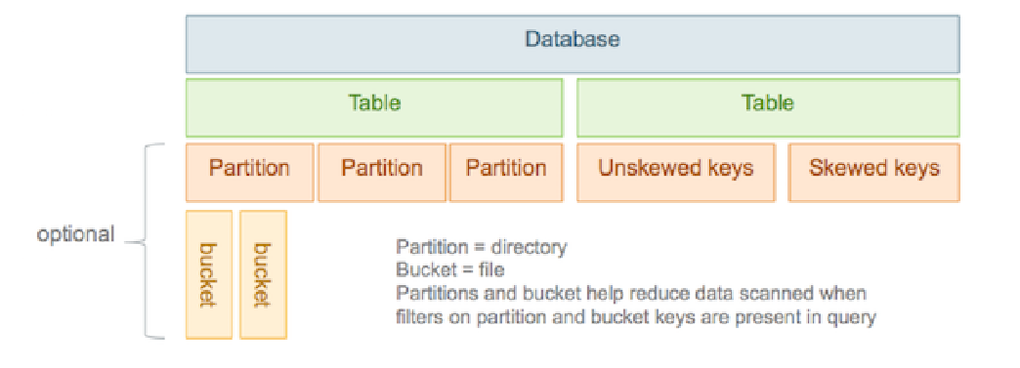
Data Model
Using partitions can significantly improve performance if a query has a filter on the partitioned columns, which can prune partition scanning to one or a few partitions that match the filter criteria.
Notes:
Frequently, tables are partitioned by date-time as incoming data is loaded into Hive each day.
Using partitions can significantly improve performance if a query has a filter on the partitioned columns, which can prune partition scanning to one or a few partitions that match the filter criteria.

Slide 24
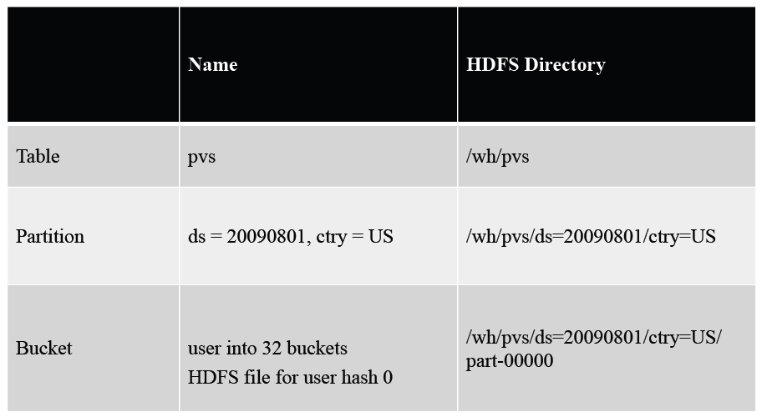
Data Model

Slide 25
HiveQL in details Data Model -- Partition
/user/hive/warehouse/users/date=20090901/state=CA
/user/hive/warehouse/users/date=20090901/state=NY
/user/hive/warehouse/users/date=20090901/state=TX
...
/user/hive/warehouse/users/date=20090902/state=CA
/user/hive/warehouse/users/date=20090902/state=NY
/user/hive/warehouse/users/date=20090902/state=TX
...
/user/hive/warehouse/users/date=20090903/state=CA
/user/hive/warehouse/users/date=20090903/state=NY
/user/hive/warehouse/users/date=20090903/state=TX

Slide 26
Data Model -- Bucket
/user/hive/warehouse/users/date=20090901/state=CA/part-00000
...
/user/hive/warehouse/users/date=20090901/state=CA/part-00031
/user/hive/warehouse/users/date=20090901/state=NY/part-00000
...
/user/hive/warehouse/users/date=20090901/state=NY/part-00031
/user/hive/warehouse/users/date=20090901/state=TX/part-00000

Slide 27
Metastore
Database: namespace containing a set of tables
Holds table definitions (column types, physical layout)
Holds partitioning information
Can be stored in MySQL and many other relational databases
Source: cc-licensed slide by Cloudera

Slide 28
MANAGING TABLES
CREATE TABLE page_view(viewTime INT, userid BIGINT,
page_url STRING, referrer_url STRING,
ip STRING COMMENT 'IP Address of the User')
PARTITIONED BY (dt STRING, country STRING)
CLUSTERED BY (userid) INTO 32 BUCKETS
ROW FORMAT DELIMITED
FIELDS TERMINATED BY '\t'
LINES TERMINATED BY '\n'
STORED AS SEQUENCEFILE;
Notes:
partition columns are optimized for querying.
The CLUSTERED BY (...) INTO ... BUCKETS clause specifies the bucketing information,
including the column that random samples will be taken from and also how many
buckets to create

Slide 29
LOADING DATA
hive> LOAD DATA LOCAL INPATH 'page_view.txt’ > OVERWRITE INTO TABLE page_view;
hive> LOAD DATA LOCAL INPATH 'page_view.txt'
> OVERWRITE INTO TABLE page_view
> PARTITION (dt='2009-09-01', country='US');

Slide 30
RUNNING QUERIES
Running HiveQL queries is similar to running SQL queries
One of the general differences
the results of HiveQL queries are relatively large.
You should almost always have an INSERT clause to tell Hive to store your query result somewhere.

Slide 31
RUNNING QUERIES
it’s some other table:
INSERT OVERWRITE TABLE query_result
Other times it’s a directory in HDFS:
INSERT OVERWRITE DIRECTORY '/hdfs_dir/query_result'
And sometimes it’s a local directory:
INSERT OVERWRITE LOCAL DIRECTORY '/local_dir/query_result'

Slide 32
User Defined Function
Package 'com. analytics.hive.udf
import org.apache.hadoop.hive.ql.exec.UDF;
import org.apache.hadoop.hive.ql.exec.Description;
import org.apache.hadoop.io.Text;
@Description(
name = "toupper",
value = "_FUNC_(str) - Converts a string to uppercase",
extended = "Example:\n" +
" > SELECT toupper(author_name) FROM authors a;\n" +
" STEPHEN KING"
)
Notes:
The package definition and imports should be self-explanatory; the @Description annotation is a useful Hive-specific annotation to provide usage information for our UDF in the Hive console.

Slide 33
public class ToUpper extends UDF {
public Text evaluate(Text s) {
Text to_value = new Text("");
if (s != null) {
try {
to_value.set(s.toString().toUpperCase());
} catch (Exception e) { // Should never happen
to_value = new Text(s);
}
}
return to_value;
}
}

Slide 34
User Defined Function
> add jar /path/to/HiveSwarm.jar;
> create temporary function to_upper as 'com. analytics.hive.udf.ToUpper';
> SELECT toupper(author_name) FROM authors a;
STEPHEN KING

Slide 35
Hive file formats
Hive originally used two simple ﬁle formats provided by Hadoop, which are TextFile and SequenceFile.
Storage efficiency shortcoming of Hive :
datatype-agnostic ﬁle formats and one-row-at-a-time serialization prevent data values being efﬁciently compressed.
New file formats:
Avro Files, ORC Files, Parquet

Slide 36
Storage Formats
Hive Text file format:a default storage format
Create table textfile_table
(column_specs) stored as textfile;
Sequence files: Hadoop flat files store values in binary key-value pairs
Create table sequencefile_table
(column_specs) stored as sequencefile;
Avro: Apache Avro is a serialization framework that allows you to write object data to a stream.

Slide 37
Storage Formats
RCFile: Optimized Row Columnar
https://orc.apache.org
Provides a highly efficient way to store data in Hive table
Improves performance when Hive is reading, writing, and processing data from large tables
Parquet
open-source columnar format offering
both high compression and high scan efficiency
http://parquet.apache.org/
Notes:
Avro serialization includes the schema with it — in JSON format — which allows you to have different versions of objects.
Avro also works well with Hadoop MapReduce.
Avro is a remote procedure call and data serialization framework developed within Apache's Hadoop project. It uses JSON for defining data types and protocols, and serializes data in a compact binary format.

Slide 38
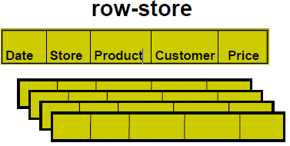
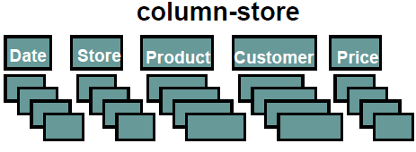
Row-Oriented vs Column-Oriented
+ easy to add/modify a record
- might read in unnecessary data
+ only need to read in relevant data
- tuple writes require multiple accesses

Slide 39
Storage Formats
表存储类型 | 详细信息
 | 压缩比 | 存储方式 | 预取优先级计算
TextFile | 低 | 行存储 | 数据表大小
RCFile | 中等 | 行列存储 | 数据表大小/行组大小
Parquet | 高 | 列式存储 | 数据表大小/文件大小
ORCFile | 高 | 行列存储 | 数据表大小/条带大小
Notes:
默认的文本格式TextFile，Hive开发的RCFile格式，Twitter和Cloudera推出的Parquet格式，在RCFile基础上优化的ORCFile格式，索引表和用户自定义存储类型等。
文本格式TextFile是Hive中数据表的默认存储文件格式，它采用水平的行存储结构，不会对数据做额外的操作，存储的是原数据的明文内容，磁盘开销大
TextFile的水平行存储结构的优点是其能较好得适应动态的查询模式。当进行Select查询时由于每一整行包含了所有的列，增加参与计算的列时，读取过程基本没有发生改变。但同时也因此带来了两个显而易见的缺陷：每次都读取所有列，降低了Hive查询的效率，而且由于不同列取值范围和数据类型的不同，导致常规的压缩算法在TextFile存储格式上的效果不佳，无法取得太高的压缩比。
Parquet存储格式增加了许多对于数据中详细内容的描述，读取时只拼装嵌套结构中需要使用的指定层级的指定部分，而不计算无关数据，从而减少许多磁盘I/O的次数。
在扫描行组的时候，将会在一次磁盘IO访问中将需要的列块读取到内存中，大大降低了随机读取的次数。
RCFile(Record-Columnar File)存储格式则采用的是行列结合的存储方式。RCFile是针对使用MapReduce系统的数据仓库设计的存储类型，它主要针对的查询和处理需求包括：数据的快速加载、节省存储空间的存储需求、适应动态的查询模式的需求、数据的快速查询处理的需求。
与上文中的Parquet存储格式相比，读取元数据信息所需要的次数取决于行组的数量，换而言之，谓词过滤阶段的磁盘I/O次数取决于数据表的大小和行组大小的比值
ORCFile(Optimized Row Columnar File)时，也就是进一步优化的RCFile格式。ORCFile存储时的结构大致分为条带、文件页尾和附录三个部分。其中条带中包含的是索引数据、行组数据和条带页尾。
ORCFile使用了比Parquet和RCFile存储格式更细粒度的索引数据，再经过合并多个离散的区间来减少磁盘I/O的次数。由上述分析可知，对于ORCFile存储格式数据表的访问的磁盘I/O的次数与每个文件大小和条带的大小的比值成正比

Slide 40
Storage Formats - Parquet
Parquet
a joint effort between Twitter and Cloudera
similar to the other columnar storage file formats available in Hadoop namely RCFile and Optimized RCFile
supports limited schema evolution where the schema can be modified according to the changes in the data.
to add new columns at the end of the file structure
only Apache Hive and Cloudera Impala are able to query such newly added columns
Notes:
Apache Parquet is a free and open source column-oriented data store of the Apache Hadoop ecosystem. It is similar to the other columnar storage file formats available in Hadoop namely RCFile and Optimized RCFile.
Parquet stores
nested elds column-wise and augments them with minimal
information to enable re-assembly of the nesting structure
from column data at scan time. Parquet has an extensible
set of column encodings.

Slide 41
Storage Formats - Parquet
Twitter和Cloudera合作推出的Parquet存储格式与上述TextFile存储格式不同，采用的是列式存储格式。
Parquet作为一种面向分析型业务的存储格式
设计目标是使其能满足关系型数据的操作，又能对嵌套类型的数据提供支持。
Notes:
Twitter和Cloudera合作推出的Parquet存储格式与上述TextFile存储格式不同，采用的是列式存储格式。Parquet作为一种面向分析型业务的存储格式，设计目标是使其能满足关系型数据的操作，又能对嵌套类型的数据提供支持。

Slide 42
Storage Formats - Parquet
存储文件主要包括首部、块组和页尾三个部分。
首部和页尾使用4个字节的魔法数来作为Parquet文件格式的标识。
每一个块组中都具有一组行组，再往下一层，每个行组中包含多个列块。
每个列块包含了它具有的数据页、字典页或索引页，而每个数据页包含了来自于相同值的列。
Notes:
arquet存储文件主要包括首部、块组和页尾三个部分。
其中首部和页尾使用4个字节的魔法数来作为Parquet文件格式的标识。而每一个块组中都具有一组行组，再往下一层，每个行组中包含多个列块。每个列块包含了它具有的数据页、字典页或索引页，而每个数据页包含了来自于相同值的列。每个列块可能使用不同的压缩算法而每个数据页的编码方式也可能不同。Parquet最核心的部分其实是页尾，因为页尾中有Parquet存储文件中的所有元

Slide 43
Storage Formats - Parquet
Parquet最核心的部分是页尾
页尾中有Parquet存储文件中的所有元数据信息，包括块组的边界，数据表的模式等。
Parquet存储文件到分布式文件系统HDFS上时，一个或多个行组存储于一个HDFS文件中，每次读写会将一个行组的数据存放于内存中。

Slide 44
Optimized Row Columnar (ORC) file format
Efficient compression: Stored as columns and compressed, which leads to smaller disk reads.
Fast reads: ORC has a built-in index, min/max values, and other aggregates that cause entire stripes to be skipped during reads.
Proven in large-scale deployments: Facebook uses the ORC file format for a 300+ PB deployment.
Notes:
The columnar format is also ideal for vectorization optimizations in Tez.
. In addition, predicate pushdown pushes filters into reads so that minimal rows are read. And Bloom filters further reduce the number of rows that are returned.

Slide 45
Optimized Row Columnar (ORC) file format
An ORC file contains groups of row data called stripes, along with auxiliary information in a file footer.
At the end of the file a postscript holds compression parameters and the size of the compressed footer.
The default stripe size is 250 MB.
Large stripe sizes enable large, efficient reads from HDFS.

Slide 46
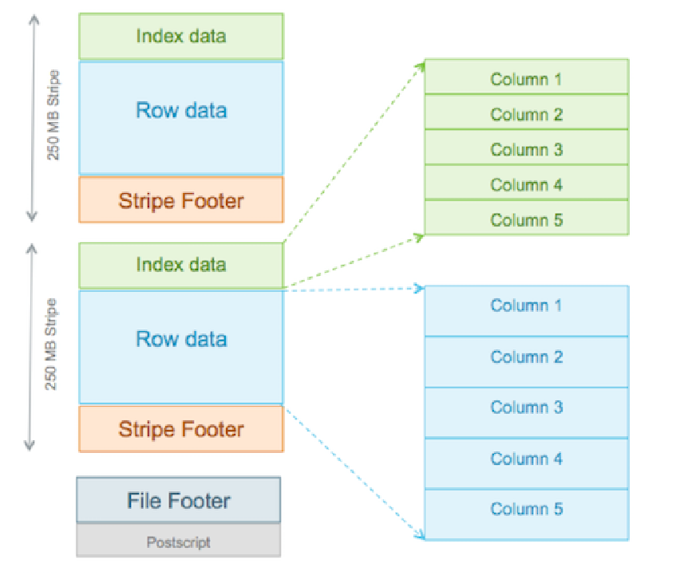
Use the ORC File Format
For a table stored in an ORC ﬁle, it is ﬁrst horizontally partitioned to multiple stripes.
A column with a complex datatype
the writer of ORC File decomposes this column to multiple child columns.
Notes:
Efficient compression: Stored as columns and compressed, which leads to smaller disk
reads. The columnar format is also ideal for vectorization optimizations in Tez.
• Fast reads: ORC has a built-in index, min/max values, and other aggregates that cause
entire stripes to be skipped during reads. In addition, predicate pushdown pushes filters
into reads so that minimal rows are read. And Bloom filters further reduce the number of
rows that are returned.
• Proven in large-scale deployments: Facebook uses the ORC file format for a 300+ PB
deployment.

Slide 47
Optimized Row Columnar (ORC) file format
The stripe footer contains a directory of stream locations.
Row data is used in table scans.
Index data includes min and max values for each column and the row positions within each column.
Row index entries provide offsets that enable seeking to the right compression block and byte within a decompressed block
Notes:
With the ability to skip large sets of rows based on filter predicates, you can sort a table on its secondary keys to achieve a big reduction in execution time. For example, if the primary partition is transaction date, the table can be sorted on state, zip code, and last name. Then looking for records in one state will skip the records of all other states.

Slide 48
Use the ORC File Format
CREATE TABLE addresses
( name string, street string, city string, state string, zip int )
STORED AS orc tblproperties ("orc.compress"="Zlib");

Slide 49
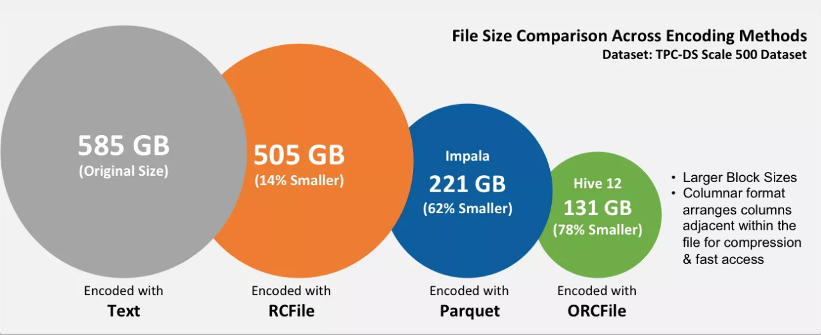
Comparison between Storage Formats

Slide 50
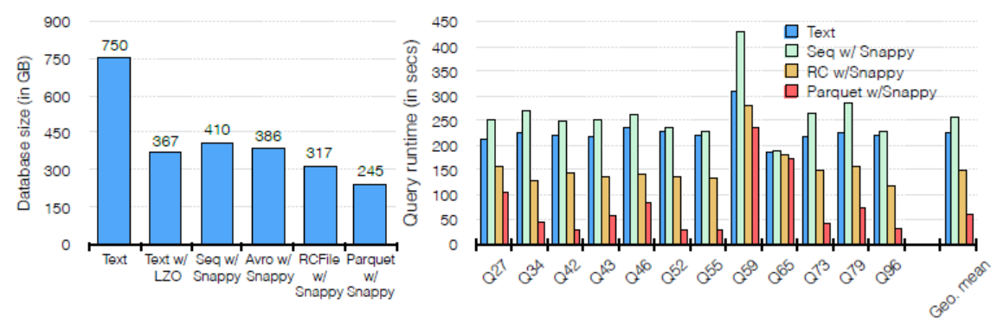
Storage Formats
Parquet with snappy compression achieves the best compression among them.
Impala execution times for various queries from the TPC-DS benchmark when the database is stored in plain text, Sequence, RC
Parquet formats. Parquet consistently outperforms by up to 5x all the other formats.
Notes:
Snappy (previously known as Zippy) is a fast data compression and decompression library written in C++ by Google based on ideas from LZ77 and open-sourced in 2011.
Snappy is widely used in Google projects like BigTable, MapReduce and in compression data in Google's internal RPC systems. It can be used in open-source projects like Cassandra, Hadoop, LevelDB, MongoDB, RocksDB, Lucene.

Slide 51
Hive Sum-up
a data warehousing layer built on top of Hadoop
added many performance-enhancing techniques (such as partitions) and usability features (such as a SQL-like language)

Slide 52
Facebooks Petabyte Scale Data Warehouse

Slide 53
Big Data in Facebook
Lots of data is generated on Facebook
– 1700+ million active users
– 30 million users update their statuses at least once each day
– More than 1 billion photos uploaded each month
– More than 10 million videos uploaded each month
– More than 1 billion pieces of content (web links, news
stories, blog posts, notes, photos, etc.) shared each week

Slide 54
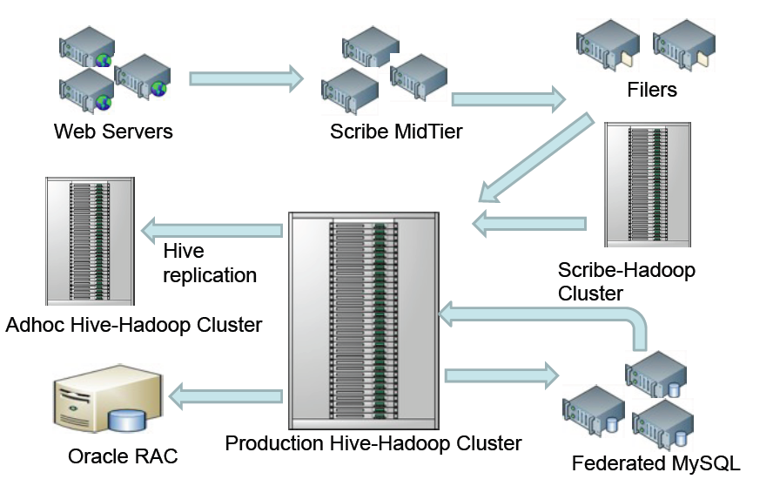
Data Flow Architecture @ Facebook

Slide 55
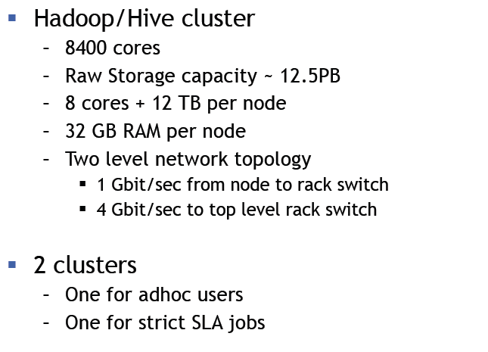
Hadoop & Hive Cluster @Facebook

Slide 56
Hive & Hadoop Usage @Facebook
2PB of uncompressed data and routinely loads 15 TB of data daily
Statistics per day
15 TB of compressed new data added per day
135TB of compressed data scanned per day
7500+ Hive jobs per day
80K compute hours per day
~200 people/month run jobs on Hadoop/Hive
Notes:
Today we regularly run thousands of jobs on the cluster with hundreds of users using this system for a wide variety of applications. Hive/Hadoop cluster at Facebook stores more than 2PB of uncompressed data and routinely loads 15 TB of data daily. It is heavily used for simple summarization jobs, business intelligence and machine learning and many other applications.

Slide 57
Hive & Hadoop Usage @Facebook
Types of Applications
Reporting
Eg: Daily/Weekly/aggregations of impression/click counts
Measures of user engagement
Ad hoc Analysis
Eg: how many group admins broken down by country
Machine Learning
Eg: User Engagement as a function of user attributes
Many others…

Slide 58
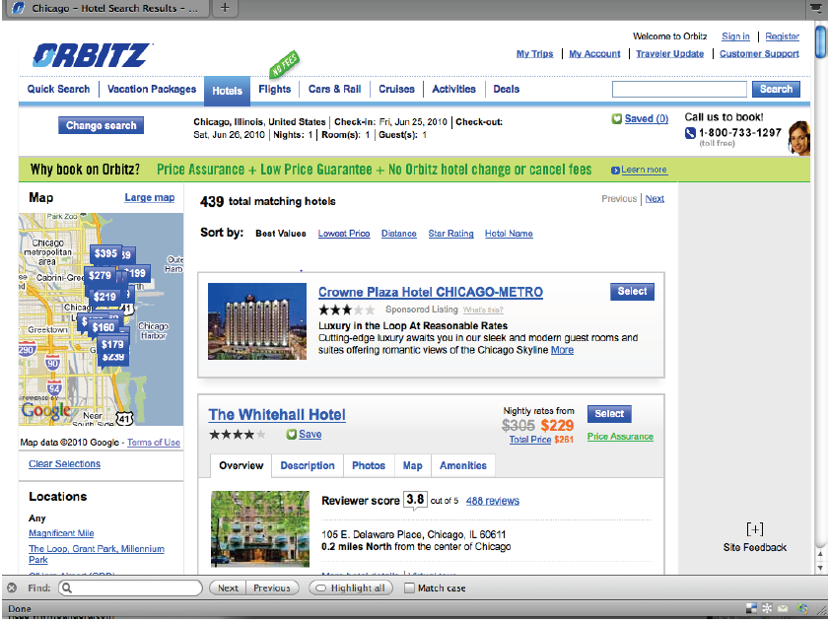

Slide 59
Data Challenges
Orbitz.com generates ~1.5 million air searches and ~1 million hotel searches every day.
All of this activity generates massive amounts of data – over 500 GB/day of log data
Expensive and difficult to use existing data infrastructure for storing and processing this data.
Need an infrastructure that provides:
Long term storage of very large data sets.
Open access to developers and analysts.
Allows for ad-hoc querying of data and rapid deployment of reporting applications

Slide 60
Improve Hotel Sort
Extract data from raw Webtrends logs for input to a trained classification process.
Logs provide input to MapReduce processing which extracts required fields.
Previous process used a series of Perl and Bash scripts to extract data serially.
Comparison of performance
– Months worth of data
– Manual process took 109min 14sec
– MapReduce process took 25min 58sec

Slide 61
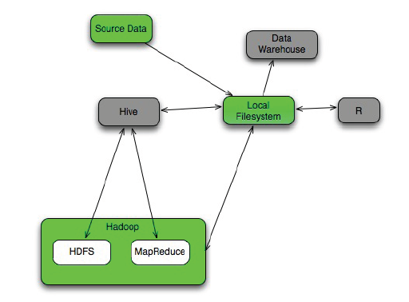
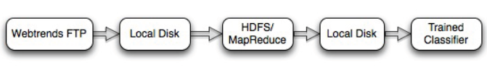
Improve Hotel Sort – Components

Slide 62
Webtrends Analysis in Hive
Extract data is loaded into two Hive tables:
DROP TABLE wt_extract;
CREATE TABLE wt_extract(
session_id STRING, visitor_tracking_id STRING, host STRING,
visitors_ip STRING, booking_date STRING, booking_time
STRING, dept_date STRING, ret_date STRING,
booked_hotel_id STRING, sort_type STRING, destination STRING, location_id STRING, number_of_guests INT, number_of_rooms INT,
page_number INT, matrix_interaction STRING, impressions STRING,
areacode STRING, city STRING, region_code STRING, country STRING, country_code STRING, continent STRING, company STRING,
tzone STRING)

Slide 63
Webtrends Analysis in Hive
CLUSTERED BY(booked_hotel_id) INTO 256 BUCKETS
ROW FORMAT DELIMITED
FIELDS TERMINATED BY '\t’
STORED AS TEXTFILE;
load data inpath ’/extract-output/part-00000' into table wt_extract;

Slide 64
Webtrends Analysis in Hive
DROP TABLE hotel_impressions;
CREATE TABLE hotel_impressions(
session_id STRING, hotel_id STRING, position INT, rate FLOAT )
CLUSTERED BY(hotel_id) INTO 256 BUCKETS
ROW FORMAT DELIMITED
FIELDS TERMINATED BY '\t' STORED AS TEXTFILE;
load data inpath ’/impressions-output/part-00000' into table hotel_extract;

Slide 65
Webtrends Analysis in Hive Cont’d
Allows us to easily derive metrics not previously possible.
Example - Find the Position of Each Booked Hotel in Search
Results:
CREATE TABLE positions(
session_id STRING,
booked_hotel_id STRING,
position INT);
Notes:
Allows us to easily derive metrics not previously possible.
• Example - Find the Position of Each Booked Hotel in Search
Results:
CREATE TABLE positions(!
session_id STRING,!
booked_hotel_id STRING,!
position INT);!
set mapred.reduce.tasks = 17;!
INSERT OVERWRITE TABLE
positions!
SELECT
e.session_id, e.booked_hotel_id, i.position!
FROM
hotel_impressions i JOIN wt_extract e!
ON
(e.booked_hotel_id = i.hotel_id and e.session_id = i.session_id);!

Slide 66
Webtrends Analysis in Hive Cont’d
set mapred.reduce.tasks = 17;
INSERT OVERWRITE TABLE positions
SELECT
e.session_id, e.booked_hotel_id, i.position
FROM hotel_impressions i JOIN wt_extract e
ON
(e.booked_hotel_id = i.hotel_id and e.session_id = i.session_id)

Slide 67
Webtrends Analysis in Hive Cont’d
Example - Aggregate Booking Position by Location by Day:
CREATE TABLE position_aggregate_by_day(
location_id STRING,
booking_date STRING,
position INT,
pcount INT);
Notes:
Example - Aggregate Booking Position by Location by Day:
CREATE TABLE position_aggregate_by_day(!
location_id STRING,!
booking_date STRING,!
position INT,!
pcount INT);!
INSERT OVERWRITE TABLE!
position_aggregate_by_day!
SELECT!
e.location_id, e.booking_date, i.position, count(1)!
FROM!
wt_extract e JOIN hotel_impressions i!
ON!
(i.hotel_id = e.booked_hotel_id and i.session_id = e.session_id)!
GROUP BY!
e.location_id,e.booking_date,i.position!

Slide 68
Webtrends Analysis in Hive Cont’d
INSERT OVERWRITE TABLE
position_aggregate_by_day
SELECT
e.location_id, e.booking_date, i.position, count(1)
FROM
wt_extract e JOIN hotel_impressions i
ON
(i.hotel_id = e.booked_hotel_id and i.session_id = e.session_id)
GROUP BY
e.location_id, e.booking_date, i.position

Slide 69
Statistical Analysis of Hive Data
Explore statistical trends and long-tails…
to help machine learning algorithms…
by choosing well understood input datasets.
• What approximations and biases exist?
• How is the Data distributed?
• Are 25+ variables pair-wise correlated?
• Are there built-in data bias? Any Lurking variables?
• Are there outlier effects on the distribution?
• Which segment should be used for ML training?

Slide 70
Statistical Analysis: Infrastructure and Dataset
• Hive + R platform for query processing and statistical analysis.
• R - Open-source stat package with visualization.
• Hive Dataset used:
– Customer hotel booking on our sites over 6 months.
– Derived from web analytics extract files from Hive.
– User rating of hotels.
– Captured major holiday travel bookings but not summer
peak.
• Costs of cleaning and processing data is non-trivial.

Slide 71
R Code Segment
HIVE> Insert overwrite local directory ‘/home/user/…/HiveExtractTable’
Select * from . . .
--------------------------------------------------------------------------------------
R> WTData <- data.frame(scan("/user/.../HiveExtractTable", what = list(0,"",0,0,0,0,0,0,0,0,0,0,0,0,0,0,0,0,0,"",
0,"",""),na.strings="NA"))
R> names(CHI) <- c("locationID”,"hotelID","rate","distance","amenities","checkin", "cleanliness", "comfort", "dining", "location”, "bookposition", "guests", "competitiveness”, "departuredate", "returndate", "stay”)
Notes:
HIVE> Insert overwrite local directory ‘/home/user/…/HiveExtractTable’!
Select * from . . .!
----------------------------------------------------------------------------------------------------------------!
R> WTData <- data.frame(scan("/user/.../HiveExtractTable", what = list(0,"",0,0,0,0,0,0,0,0,0,0,0,0,0,0,0,0,0,"",
0,"",""),na.strings="NA"))!
R> names(CHI) <- c("locationID”,"hotelID","rate","distance","amenities","checkin", "cleanliness", "comfort",
"dining", "location”, "bookposition", "guests", "competitiveness”, "departuredate", "returndate", "stay”)!
CHI <- WTData[which(WTData[,1] == '7840'|'35416'|'37961'|'38422'|'37795'| '37769'|'37730'|'33728'|'38123'),]!
R> summary(CHI)!
----------------------------------------------------------------------------------------------------------------!
R> library(corrgram)!
R> corrgram(CHI,order=NULL,lower.panel=panel.ellipse)!
----------------------------------------------------------------------------------------------------------------!
R> pdf(file="/user/.../himp.pdf") !
R> par(mfrow=c(2,1))!
R> bin1 <-hexbin(CHI[,15],CHI[,4], xbins=25)!
R> hsmooth(bin1,c(48,24,0))!
R> plot(bin1,xlab="Position", ylab="Price($)", main="Booked Hotel Impressions", colramp=function(n){plinrain
(n,beg=35,end=225)})!
R> bin2 <-hexbin(CHI[,15], CHI[,22], xbins=25)!

Slide 72
R Code Segment
CHI <- WTData[which(WTData[,1] == '7840'|'35416'|'37961'|'38422'|'37795'| '37769'|'37730'|'33728'|'38123'),]
R> summary(CHI)
R> library(corrgram)
R>corrgram(CHI,order=NULL,lower.panel=panel.ellipse)

Slide 73
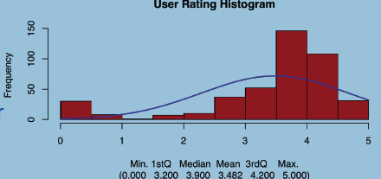
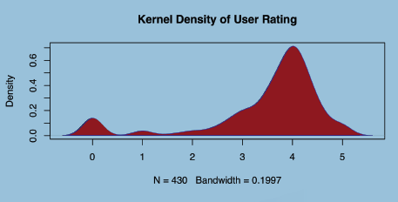
Statistical Analysis - Kernel Density
User Ratings of Hotels
Strongly affected by the number of bins used.
Kernel density plots are usually a much more effective way to overcome the limitations of histograms.

Slide 74
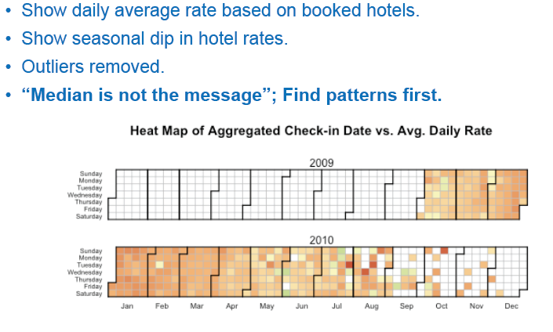
Statistical Analysis - Visual Analytics

Slide 75
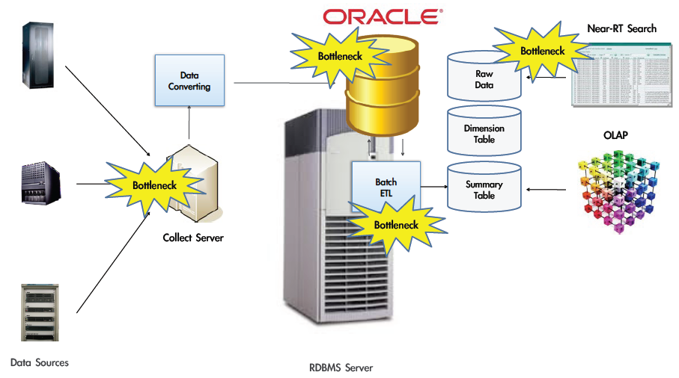
Typical Oracle ETL System
Notes:
Extraction-Transformation-Loading
On-Line Transaction Processing

Slide 76
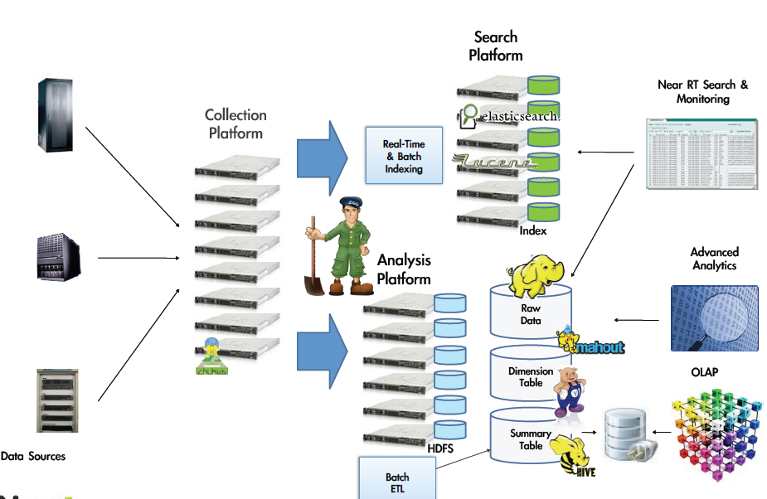
Hadoop Hive Data Analytic Platform

Slide 77
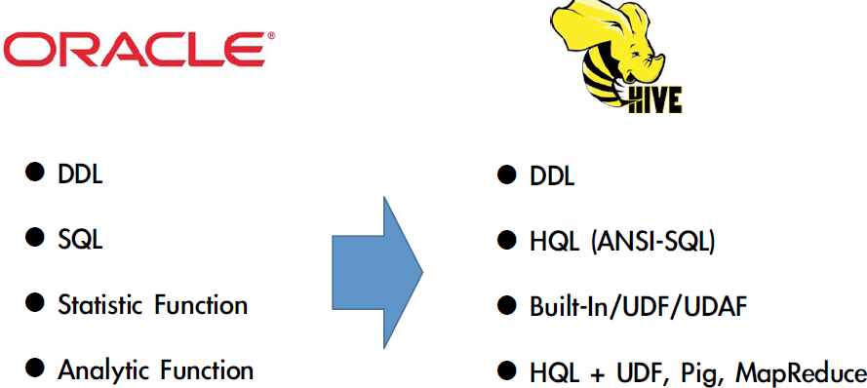
Oracle to Hive
Notes:
􀀰􀁓􀁂􀁄􀁍􀁆 􀁕􀁐 􀀩􀁊􀁗􀁆

Slide 78
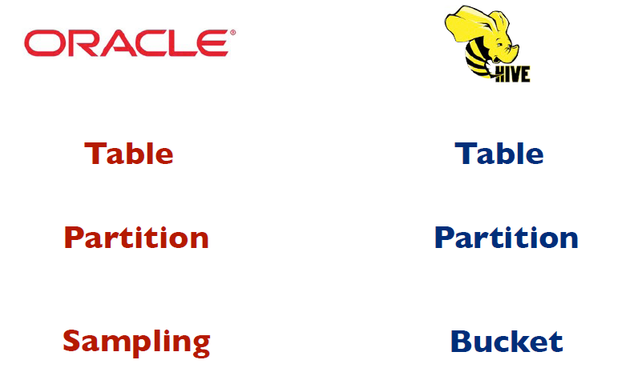
Data Model Convert

Slide 79
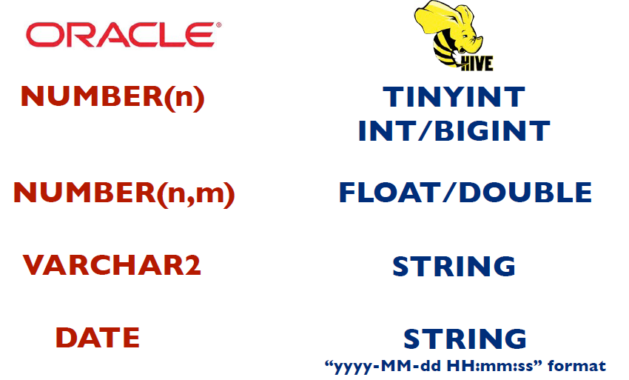
Data Type Convert

Slide 80
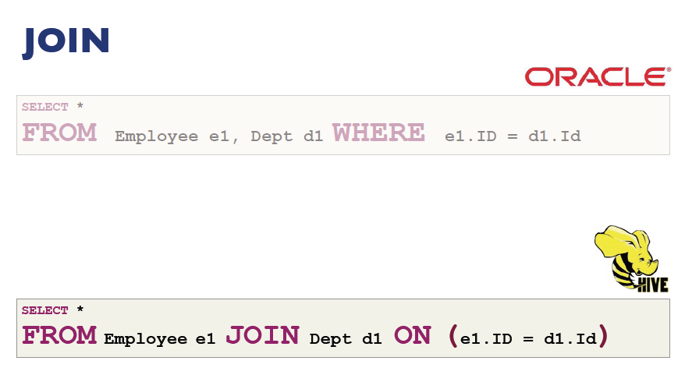
Join Operator

Slide 81
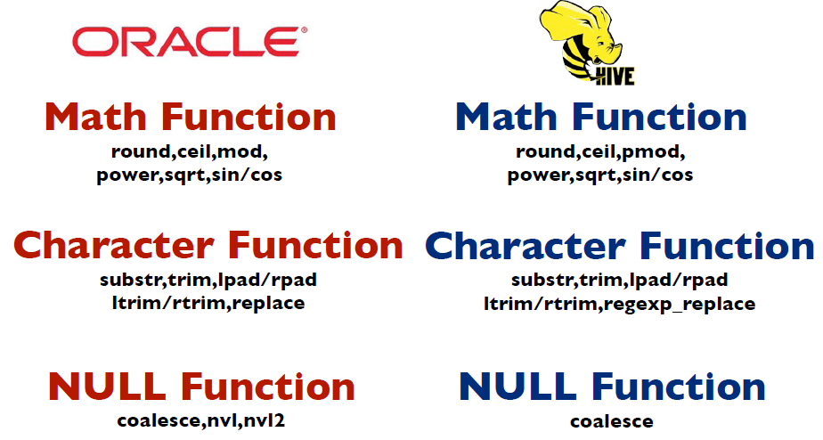
Functions

Slide 82
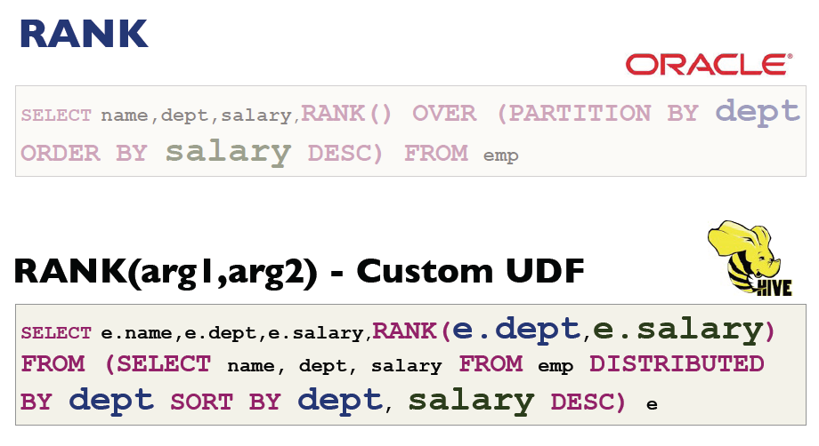
Analytic Function

Slide 83
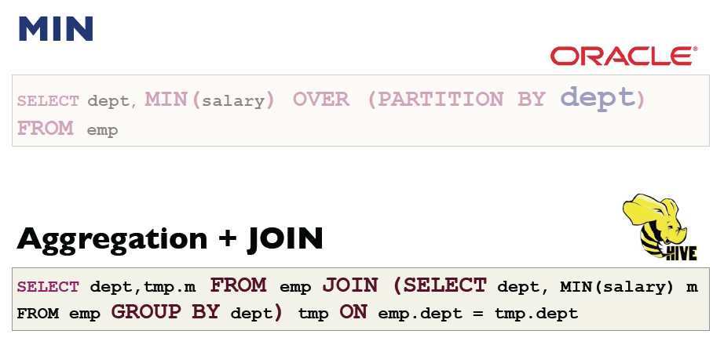
Analytic Aggregation Function

